Slide 1
Unit 1: Introduction to ASP.NET MVC
Notes:
http://www.asp.net/mvc/overview/getting-started/introduction/getting-started
https://yoshiku.wordpress.com/2012/06/14/bat-dau-voi-asp-net-mvc3-phan-1-gioi-thieu-asp-net-mvc3/
https://www.youtube.com/watch?v=_yxxwZB2CgE
https://www.youtube.com/watch?v=D4FCEk0-In8

Slide 2
Lesson: ASP.NET MVC
MVC Overview
ASP.NET MVC Overview
Features of the ASP.NET MVC Framework
Understanding ASP.NET Routing
How to create new ASP.NET MVC
Q&A
Reference

Slide 3
MVC Overview
The Model-View-Controller (MVC) architectural pattern separates an application into three main components: the model, the view, and the controller.
Notes:
MVC là viết tắt của Model-View-Controller. MVC là một mẫu thiết dùng cho việc phát triển ứng dụng có kiến trúc tốt và dễ dàng bảo trì. Ứng dụng MVC bao gồm: Controllers, Models, Views

Slide 4
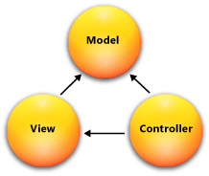
MVC Overview
Models. Model objects are the parts of the application that implement the logic for the application s data domain.
Views. Views are the components that display the application s user interface (UI).
Controllers. Controllers are the components that handle user interaction, work with the model, and ultimately select a view to render that displays UI
Notes:
Models: gồm các class đại diện cho dữ liệu của ứng dụng và nó sử dụng validate logic để tạo ra các ràng buộc nguyên tắc nghiệp vụ cho dữ liệu.
Views: gồm các file template được ứng dụng của bạn sử dụng để generate HTML response động.
Controllers: gồm các class xử lí các request, nhận dữ liệu từ model, và sau đó chỉ định view template nào sẽ nào response cho client.

Slide 5
ASP.NET MVC Overview
The ASP.NET MVC framework provides an alternative to the ASP.NET Web Forms pattern for creating MVC-based Web applications.
The ASP.NET MVC framework is a lightweight, highly testable presentation framework that (as with Web Forms-based applications) is integrated with existing ASP.NET features, such as master pages and membership-based authentication.

Slide 6
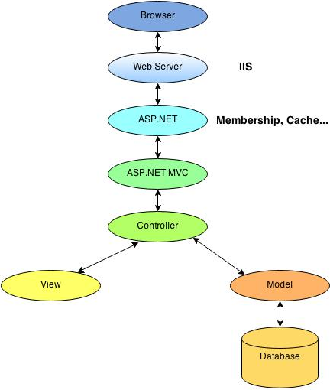
ASP.NET MVC Overview Working Model

Slide 7
Features of the ASP.NET MVC
Separation of application tasks (input logic, business logic, and UI logic), testability, and test-driven development (TDD).
An extensible and pluggable framework.
Extensive support for ASP.NET routing, which is a powerful URL-mapping component that lets you build applications that have comprehensible and searchable URLs.
Support for using the markup in existing ASP.NET page (.aspx files), user control (.ascx files), and master page (.master files) markup files as view templates.
Support for existing ASP.NET features.
Notes:
- Tách rõ ràng các mối liên quan, mở khả năng test TDD ( Test Driven Developer). Có thể test unit trong ứng dụng mà không cần phải chạy Controllers cùng với tiến trình của ASP.net và có thể dùng bất kỳ một unit testing framework như NUnit, MBUnit, MS Test…
- Có khả năng mở rộng, mọi thứ trong MVC được thiết kế dễ dàng thay thế/ tùy biến (ví dụ có thể lựa chọn engine view riêng routing policy, parameter serialization, …).
- Bao gồm ánh xạ URL mạnh mẽ, cho phép xây dựng ứng dụng với những URL sạch, các URL không cần cs mở rộng (ví dụ có thể ánh xạ địa chỉ /Products/Edit/4 để thực hiện hành động edit của lớp điều khiển ProductControllers hoặc ánh xạ địa chỉ Blog/SomeTopic để thực hiện hành động “Display Topic” của lớp điều khiển BlogEngineController ).
- ASP.net MVC Framework cũng hỗ trợ file ASP.net như .ASPX .ASCX và .Master đánh dấu các tập tin này như một “view template” (có thể dễ dàng sử dụng các tính năng của ASP.net như lồng các trang Master, <%=%> snippets, mô tả server controls, template, data-binding, localization…). Tuy nhiên sẽ không còn postback và interactive back server và thay vào đó là interactive end-user với một controller class (không còn viewstate, page lifecycle).
- ASP.net MVC Framework hỗ trợ đầy đủ các tính năng bảo mật của ASP.net như Form/ Windows authenticate, URL authorization, membership/roles, output và data caching, section/ profile state, configuration system, provider architecture, …

Slide 8
Understanding ASP.NET Routing
A browser request gets mapped to a controller action through a feature of the ASP.NET framework called ASP.NET Routing.
ASP.NET Routing uses a route table to handle incoming requests.
The route table is setup in the Global.asax file.
Notes:
Nói như vậy không có nghĩa là ASP.NET Web form chậm hay ASP.NET MVC không tốt, không linh động hay … Cả 2 đều cùng một chủ (Microsoft) nên tất nhiên mỗi nền tảng đều có mặt tốt, mặt hạn chế của nó. Nếu nó lỗi thời hay yếu kém thì Microsft đã loại bỏ hoặc không quảng bá nó hay tiếp tục phát triển nó. Vấn đề ở đây là làm sao để sử dụng nó một các hiệu quả. Điều đó phụ thuộc vào chính các nhà phát triển website, phụ thuộc vào việc phân tich ứng dụng của bạn. Từ đó đưa ra một giải pháp thích hợp là nên chọn ASP.NET Web form hay ASP.NET MVC.
Vậy ta có thể nói ASP.NET Web form và ASP.NET MVC là 2 nền tảng tốt. Việc chọn bên nào là phụ thuôc tính chất của dụ án mà bạn phát triển cùng những kinh nghiệm mà bạn có.

Slide 9
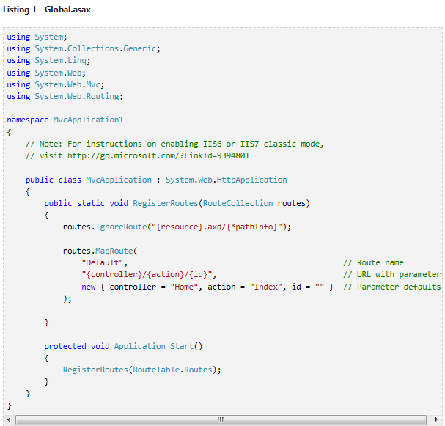
Understanding ASP.NET Routing
When an ASP.NET application first starts, the Application_Start() method is called. In Listing 1, this method calls the RegisterRoutes() method and the RegisterRoutes() method creates the default route table.
Notes:
The default route table consists of one route. This default route breaks all incoming requests into three segments (a URL segment is anything between forward slashes). The first segment is mapped to a controller name, the second segment is mapped to an action name, and the final segment is mapped to a parameter passed to the action named Id.
For example, consider the following URL:
/Product/Details/3
This URL is parsed into three parameters like this:
Controller = Product
Action = Details
Id = 3
The Default route defined in the Global.asax file includes default values for all three parameters. The default Controller is Home, the default Action is Index, and the default Id is an empty string. With these defaults in mind, consider how the following URL is parsed:
/Employee
This URL is parsed into three parameters like this:
Controller = Employee
Action = Index
Id = ��
Finally, if you open an ASP.NET MVC Application without supplying any URL (for example, http://localhost) then the URL is parsed like this:
Controller = Home
Action = Index
Id = ��
The request is routed to the Index() action on the HomeController class.

Slide 10
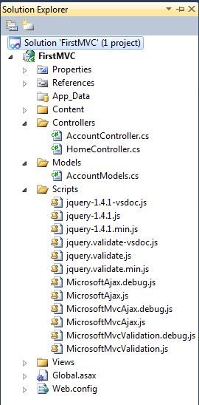
How to create new ASP.NET MVC Create new project
Step 1 : Open VS 2010
Step 2 : Select Visual C# on the left, then pick "ASP.NET MVC 2 Web Application." Name your project “First MVC" and click OK.
If you want Unit Test Project check on Yes, if don’t need check on No
Step 3 : On the right-hand side is the Solution Explorer showing all the files and folders in your application.

Slide 11
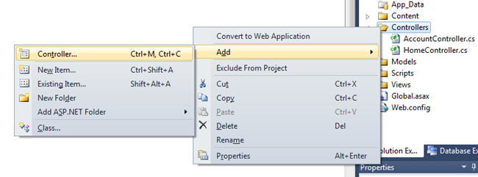
How to create new ASP.NET MVC Adding a Controller - 1
create a new controller by right-clicking the controllers folder in the solution Explorer and selecting Add Controller.
Name your new controller "HelloWorldController" and click Add.

Slide 12
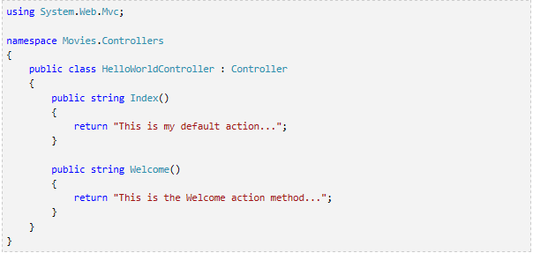
How to create new ASP.NET MVC Adding a Controller - 2
Create two new methods that look like this inside of your new public class HelloWorldController. We'll return a string of HTML directly from our controller as an example.

Slide 13
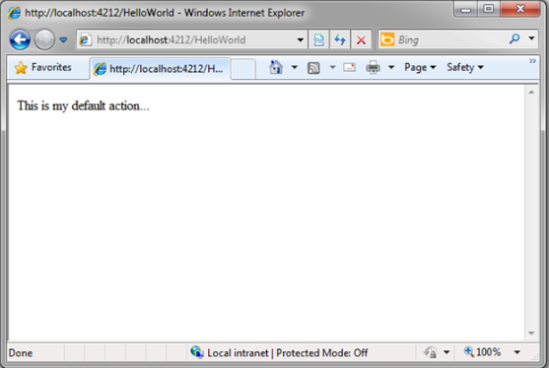
How to create new ASP.NET MVC Adding a Controller - 3
Let's visit http://localhost:xx/HelloWorld

Slide 14
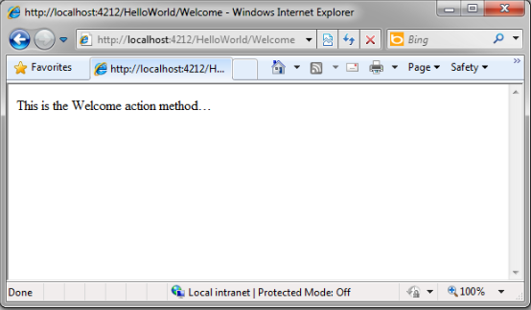
How to create new ASP.NET MVC Adding a Controller - 4
Let's visit http://localhost:xx/HelloWorld/Welcome.

Slide 15

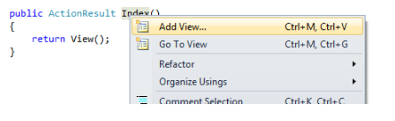
How to create new ASP.NET MVC Adding a View - 1
Let's now change the Index method to instead look like this:
Let's now add a View template to our project that we can use for our Index() method.
This will bring up the "Add View" dialog, don’t change anything, and just click the Add button.
Notes:
Let's now add a View template to our project that we can use for our Index() method. To do this, right-click with your mouse somewhere in the middle of the Index method and click Add View...
This will bring up the "Add View" dialog which provides us some options for how we want to create a view template that can be used by our Index method. For now, don't change anything, and just click the Add button.

Slide 16
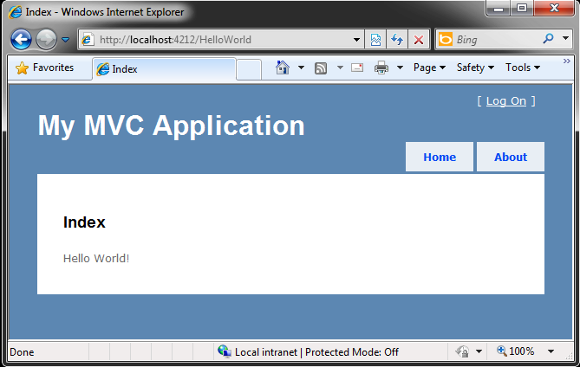
How to create new ASP.NET MVC Adding a View - 2
Let's visit http://localhost:xx/HelloWorld

Slide 17
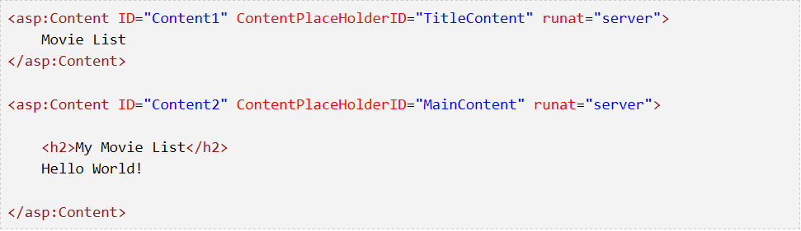
How to create new ASP.NET MVC Adding a View - 3
Changing Views and Master Pages
Go to the /Views/Shared folder in the Solution Explorer and open the Site.Master file.
This file is called a Master Page and it's the shared "shell" that all our other pages use.
let's change the title of the Index page.

Slide 18
How to create new ASP.NET MVC Adding a View - 3
Changing Views and Master Pages
Go to the /Views/Shared folder in the Solution Explorer and open the Site.Master file.
This file is called a Master Page and it's the shared "shell" that all our other pages use.
That placeholder is where all the pages you create will show up, "wrapped" in the master page.

Slide 19
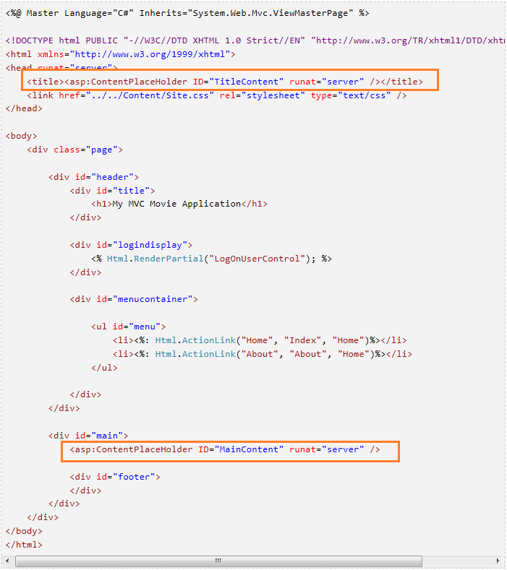
How to create new ASP.NET MVC Adding a View - 3

Slide 20
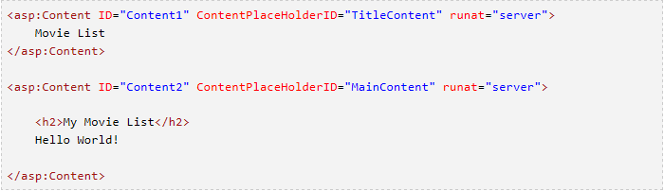
How to create new ASP.NET MVC Adding a View - 4
Changing Title of the Index page
Open /HelloWorld/Index.aspx.
There's two places to change.
First, the Title that appears in the title of the browser,
The secondary header - that's H2 - as well.

Slide 21
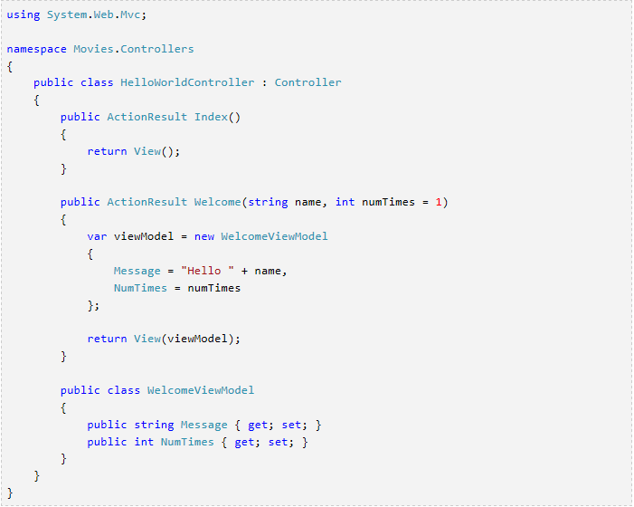
How to create new ASP.NET MVC Parsing a ViewModel
Change the Welcome method inside your controller.
Notes:
Return to the HelloWorldController.cs file and add a new "WelcomeViewModel" class and change the Welcome method inside your controller. Here is the complete HelloWorldController.cs with the new class in the same file.

Slide 22
How to create new ASP.NET MVC Parsing a ViewModel
Change the Welcome method inside your controller.
Notes:
Return to the HelloWorldController.cs file and add a new "WelcomeViewModel" class and change the Welcome method inside your controller. Here is the complete HelloWorldController.cs with the new class in the same file.

Slide 23
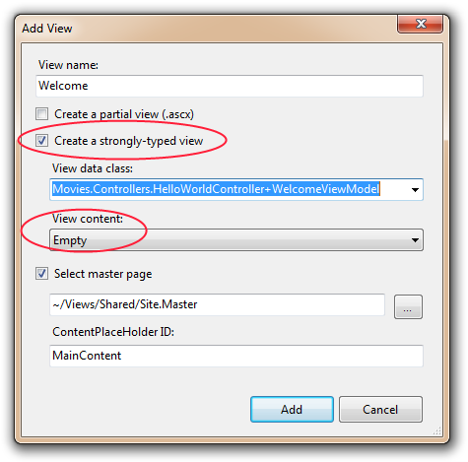
How to create new ASP.NET MVC Parsing a ViewModel
Now we need a Welcome View template
Notes:
Right click in the Welcome method and select Add View. This time, we'll check "Create a strongly-typed view" and select our WelcomeViewModel class from the drop down list. This new view will only know about WelcomeViewModels and no other types of objects.
NOTE: You'll need to have compiled once after adding your WelcomeViewModel for to show up in the drop down list.

Slide 24

How to create new ASP.NET MVC Parsing a ViewModel
Add this code under the <h2> in your new Welcome.aspx.
Notes:
Also, notice while you're typing that because we told this View about the WelcomeViewModel (they are married, remember?) that we get helpful Intellisense each time we reference our Model object.

Slide 25
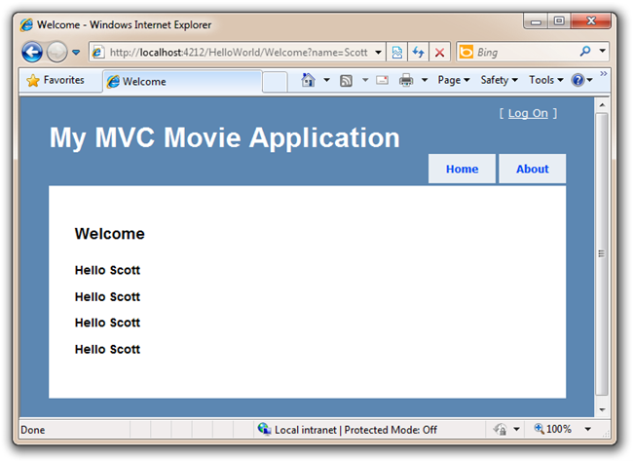
How to create new ASP.NET MVC Parsing a ViewModel
Notes:
Also, notice while you're typing that because we told this View about the WelcomeViewModel (they are married, remember?) that we get helpful Intellisense each time we reference our Model object.

Slide 26

Demo
Notes:
Refer to this link to demo
http://www.asp.net/mvc/tutorials/older-versions/getting-started-with-mvc/getting-started-with-mvc-part1

Slide 27

Q&A

